Slide 1
Workshop 2
Grant Adams

Slide 2
Simulating data

Slide 3
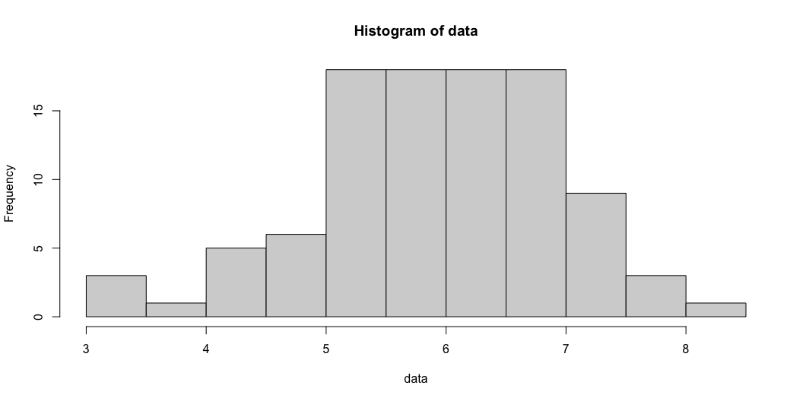
Normal distribution (1)
The normal distribution is defined by
$$p\left(x|μ,σ\right)=∏\frac{1}{\sqrt{2πσ^{2}}}e^{−\frac{{\left(x−μ\right)}^{2}}{2σ^{2}}}$$
where $x$ are the observations, $μ$ is the mean, and $σ$ is the standard deviation. Data can be simulated from a normal distribution using rnorm and we can plot the distribution of data using the hist function.
data <- rnorm(n = 100, mean = 6, sd = 1) hist(data)

Slide 4
Normal distribution (2)
The probability density is specified by dnorm. The probability of getting 0 in the above distribution is very low compared to the probability of getting a 6:
dnorm(0, mean = 6, sd = 1)
[1] 6.075883e-09
dnorm(6, mean = 6, sd = 1)
[1] 0.3989423

Slide 5
Simulating data for a model (1)

Slide 6
Simulating weight-at-length (1)
We can simulate data for a model by first defining the function relating the data to the parameters $f\left(θ\right)$. When relating weight and length of fish, a common model used is the power function:
$$Peso=α*Longitud^{β}$$
The model can be realized by taking the log:
$$log\left(Peso\right)=log\left(α\right)+β*log\left(Longitud\right)$$

Slide 7
Simulating weight-at-length (2)
We can simulate random lengths of 100 fish using the runif function
nobs = 500 longitud <- runif(nobs, min = 5, max = 130) beta = 3 alpha = 1e-05 # kg per cm^3 log_peso <- log(alpha) + beta * log(longitud) peso = exp(log_peso)

Slide 8
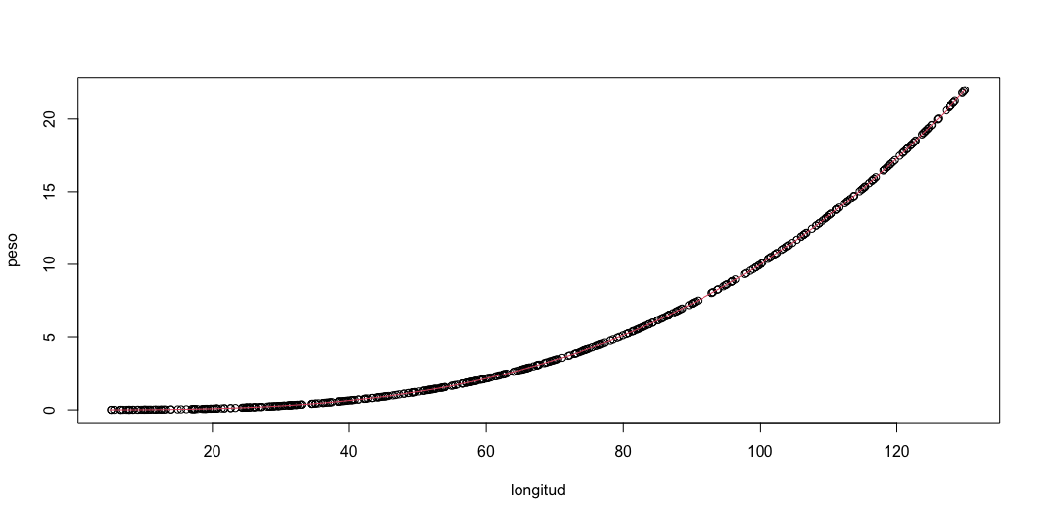
Simulating weight-at-length (3)
The data can be plot
plot(x = longitud, y = peso) curve(alpha*x^beta, from = 5, to = 130, add = TRUE, col = 2)

Slide 9
Simulating weight-at-length (4)
This does not include sampling error! We can add lognormal sampling error using rnorm to the log function:
The model can be realized by taking the log:
$$log\left(Peso\right)=log\left(α\right)+β*log\left(Longitud\right)+ϵ$$
$$ϵ∼N\left(0,σ\right)$$

Slide 10
for loops for simulating
log_peso_obs <- c() # empty vector peso_obs <- c() # empty vector # Loop through th vector from 1 until length of `log_peso` for(i in 1:length(log_peso)){ log_peso_obs[i] = log_peso[i] + rnorm(1, 0, sd = 0.2) peso_obs[i] = exp(log_peso_obs[i]) } # log_peso_obs = exp(log_peso + rnorm(100, 0, sd = 0.2))

Slide 11
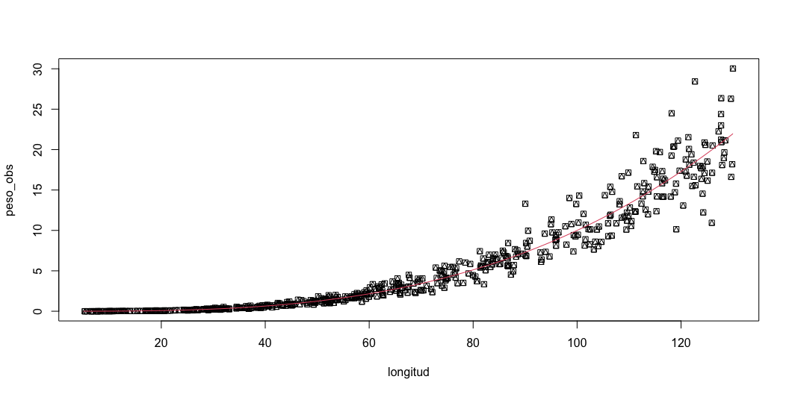
Simulating weight-at-length (6)
The data can be plot
plot(x = longitud, y = peso_obs, pch = 14) curve(alpha*x^beta, from = 5, to = 130, add = TRUE, col = 2)

Slide 12
Fitting to simulated data
Use the lm function to fit to the weight-at-length
mod <- lm(log(peso_obs) ~ log(longitud)) summary(mod)
Call: lm(formula = log(peso_obs) ~ log(longitud)) Residuals: Min 1Q Median 3Q Max -0.5786 -0.1260 0.0055 0.1336 0.6158 Coefficients: Estimate Std. Error t value Pr(>|t|) (Intercept) -11.42943 0.05017 -227.8 <2e-16 *** log(longitud) 2.97807 0.01238 240.6 <2e-16 *** --- Signif. codes: 0 '***' 0.001 '**' 0.01 '*' 0.05 '.' 0.1 ' ' 1 Residual standard error: 0.2009 on 498 degrees of freedom Multiple R-squared: 0.9915, Adjusted R-squared: 0.9915 F-statistic: 5.79e+04 on 1 and 498 DF, p-value: < 2.2e-16

Slide 13
Fitting to observed data

Slide 14
Loading data
Average weight of chinook salmon in Argentina from:
Soto, D., I. Arismendi, C. Di Prinzio, and F. Jara. 2007. Establishment of Chinook Salmon (Oncorhynchus tshawytscha) in Pacific basins of southern South America and its potential ecosystem implications. Revista Chilena d Historia Natural, 80:81-98. [http://www.scielo.cl/pdf/rchnat/v80n1/art07.pdf.]
ILook at what the data structure is:
tl w loc 1 120.1 17.9 Argentina 2 115.0 17.2 Argentina 3 111.2 16.8 Argentina 4 110.2 15.8 Argentina 5 110.0 14.3 Argentina 6 109.7 13.8 Argentina

Slide 15
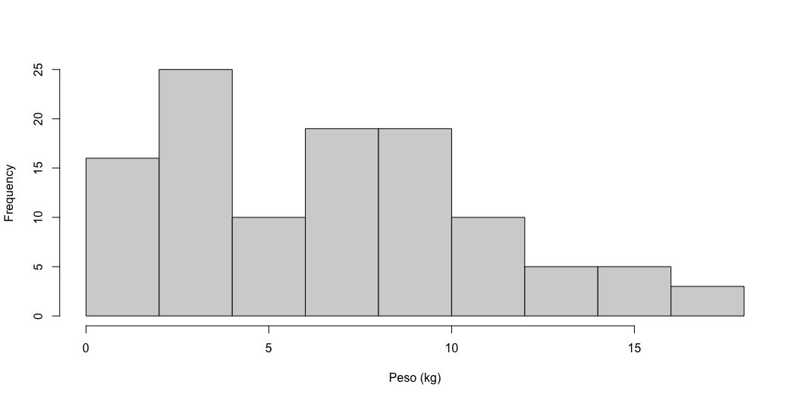
hist(chinook$w, xlab = "Peso (kg)", main = NA)

Slide 16
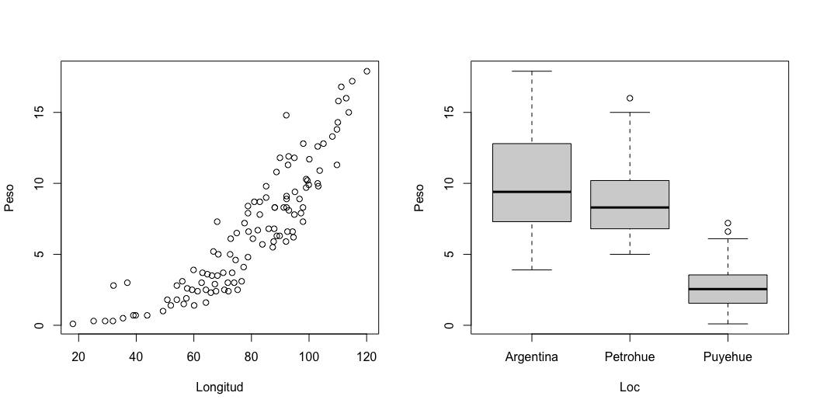
Initial plots

Slide 17
Fitting to observed data (1)
Use the lm function to fit to the weight-at-length
mod <- lm(log(w) ~ log(tl), data = chinook) summary(mod)
Call: lm(formula = log(w) ~ log(tl), data = chinook) Residuals: Min 1Q Median 3Q Max -0.69071 -0.21434 -0.00143 0.17011 1.70527 Coefficients: Estimate Std. Error t value Pr(>|t|) (Intercept) -9.86574 0.42048 -23.46 <2e-16 *** log(tl) 2.64931 0.09707 27.29 <2e-16 *** --- Signif. codes: 0 '***' 0.001 '**' 0.01 '*' 0.05 '.' 0.1 ' ' 1 Residual standard error: 0.3516 on 110 degrees of freedom Multiple R-squared: 0.8713, Adjusted R-squared: 0.8701 F-statistic: 744.8 on 1 and 110 DF, p-value: < 2.2e-16

Slide 18
Fitting to observed data (2)
Custom function
lm_fun <- function(pars, y, x){ alpha <- pars[1] beta <- pars[2] sigma <- exp(pars[3]) # Exp to keep positive nll = -sum(dnorm(y, alpha + beta * x, sigma, log = TRUE )) return(nll) } fit <- nlminb(start = c(1,2,1), lm_fun, y = log(chinook$w), x = log(chinook$tl)) fit$par
[1] -9.865737 2.649314 -1.054245

Slide 19
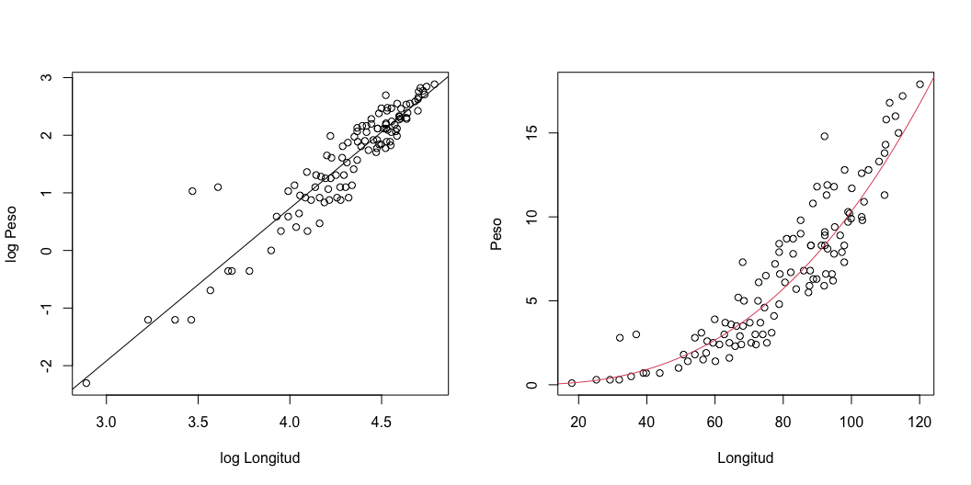
Diagnostics
Extract model coefficients using mod$coefficients to get $log\left(α\right)$ and $β$ and plot
# En log par(mfrow = c(1,2)) plot(y = log(chinook$w), x = log(chinook$tl), ylab = "log Peso", xlab = "log Longitud") abline(mod) # En natural alpha_hat = exp(mod$coefficients[1]) beta_hat = mod$coefficients[2] plot(y = chinook$w, x = chinook$tl, ylab = "Peso", xlab = "Longitud") curve(alpha_hat * x^ beta_hat, from = 5, to = 130, add = TRUE, col = 2)

Slide 20
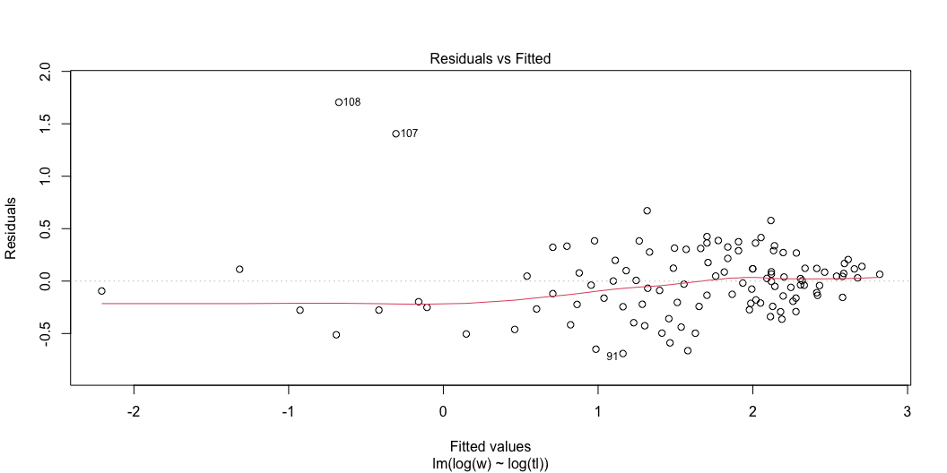
Diagnostic plots
plot(mod)

Slide 21
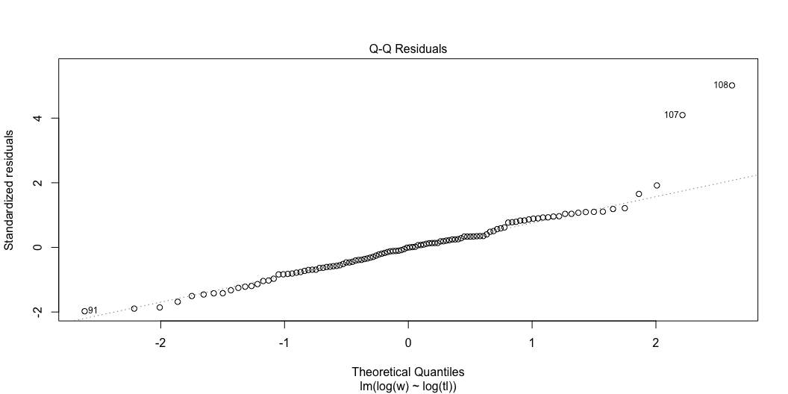

Slide 22
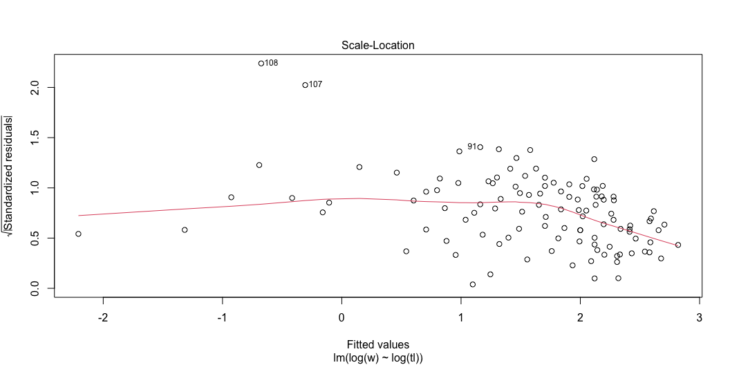

Slide 23
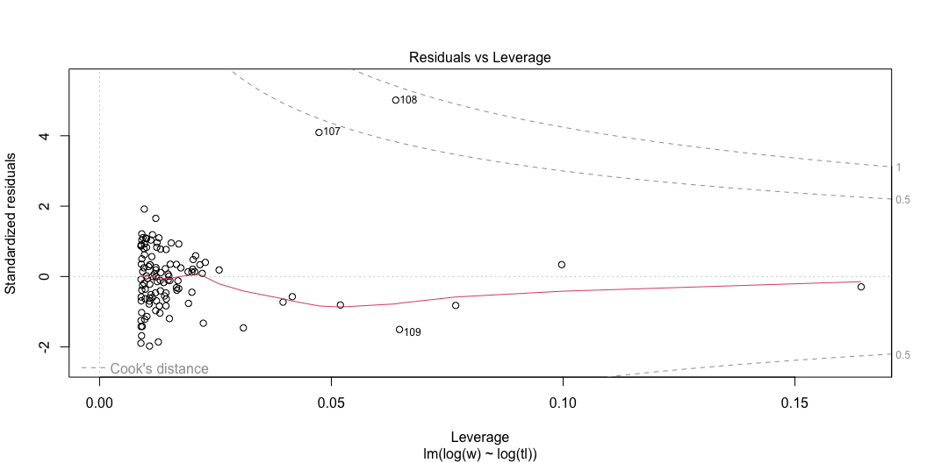

Slide 24
Uncertainty (1)
Uncertainty of the parameters can extracted using summary
95% confidence interval $θ±1.96SE$
summ <- summary(mod) summ
Call: lm(formula = log(w) ~ log(tl), data = chinook) Residuals: Min 1Q Median 3Q Max -0.69071 -0.21434 -0.00143 0.17011 1.70527 Coefficients: Estimate Std. Error t value Pr(>|t|) (Intercept) -9.86574 0.42048 -23.46 <2e-16 *** log(tl) 2.64931 0.09707 27.29 <2e-16 *** --- Signif. codes: 0 '***' 0.001 '**' 0.01 '*' 0.05 '.' 0.1 ' ' 1 Residual standard error: 0.3516 on 110 degrees of freedom Multiple R-squared: 0.8713, Adjusted R-squared: 0.8701 F-statistic: 744.8 on 1 and 110 DF, p-value: < 2.2e-16

Slide 25
Uncertainty (2)
95% CI of $log\left(α\right)$ and $β$

Slide 26
Uncertainty (3)
What if we want uncertainty around $α$ instead of $log\left(α\right)$?

Slide 27
Uncertainty (4)
Can use:
Simulation
Bootstrap
Delta method

Slide 28
Bootstrap (1)
Resampling the data with replacement and fitting the model
Summarize model estimates to get uncertainty
nboot = 10000 pars <- data.frame(Alpha = rep(0, nboot), Beta = rep(0, nboot)) for(i in 1:nboot){ rows_boot <- sample(1:nobs, nobs, replace = TRUE) data <- data.frame(w = peso_obs[rows_boot], tl = longitud[rows_boot]) mod_tmp <- lm(log(w) ~ log(tl), data = data) pars$Alpha[i] <- exp(mod_tmp$coefficients[1]) pars$Beta[i] <- mod_tmp$coefficients[2] }

Slide 29
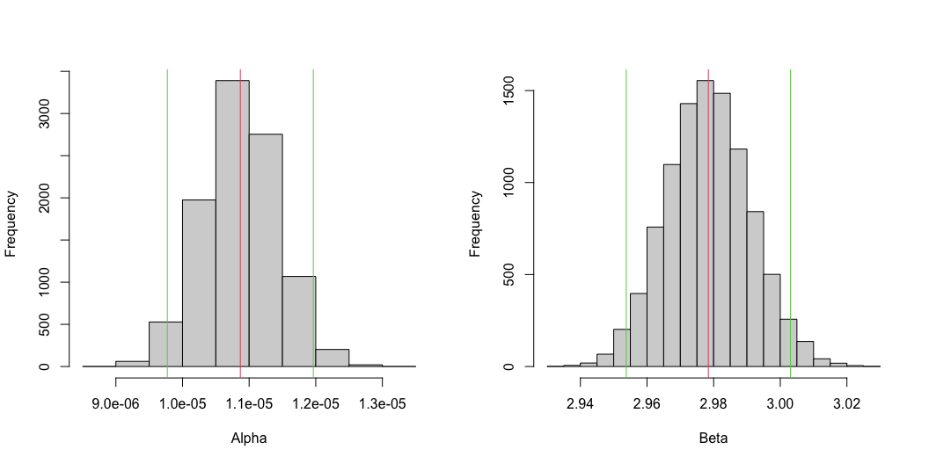
Bootstrap (2)
Get 95% CI and mean

Slide 30
Simulation (1)
We can simulate from the variance covariance and transform
library(MASS) sim_pars <- mvrnorm(n = 10000, mu = mod$coefficients, Sigma = vcov(mod)) sim_pars <- as.data.frame(sim_pars) colnames(sim_pars) <- c("log_alpha", "Beta") sim_pars$Alpha <- exp(sim_pars$log_alpha) head(sim_pars)
log_alpha Beta Alpha 1 -9.097669 2.481577 1.119264e-04 2 -9.561991 2.583014 7.035258e-05 3 -9.723105 2.621555 5.988380e-05 4 -9.538814 2.581466 7.200217e-05 5 -10.031062 2.682719 4.401140e-05 6 -9.718573 2.609678 6.015581e-05

Slide 31
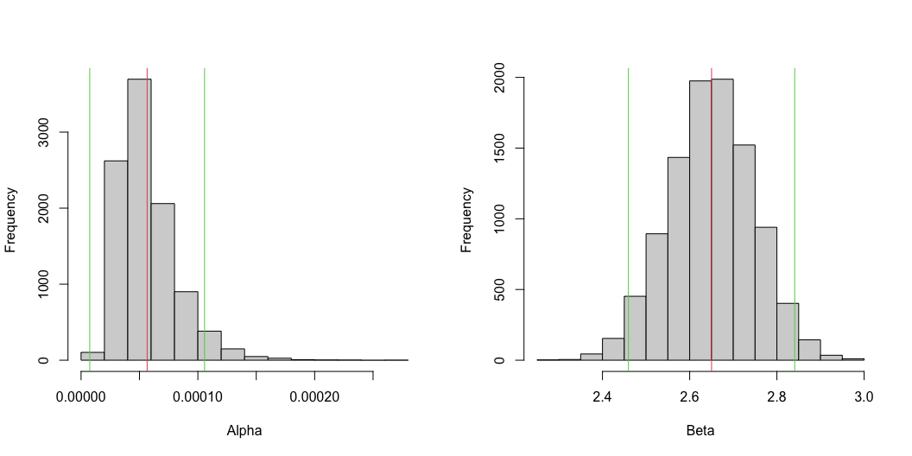
Simulation (2)
par(mfrow = c(1, 2)) # Alpha hist(sim_pars$Alpha, xlab = "Alpha", main = NA) abline(v = mean(sim_pars$Alpha), col = 2) # Mean abline(v = mean(sim_pars$Alpha) - 1.96 * sd(sim_pars$Alpha), col = 3) abline(v = mean(sim_pars$Alpha) + 1.96 * sd(sim_pars$Alpha), col = 3) # Beta hist(sim_pars$Beta, xlab = "Beta", main = NA) abline(v = mean(sim_pars$Beta), col = 2) # Mean abline(v = mean(sim_pars$Beta) - 1.96 * sd(sim_pars$Beta), col = 3) abline(v = mean(sim_pars$Beta) + 1.96 * sd(sim_pars$Beta), col = 3)

